Slide 1
AI Adoption & Business Performance Analysis
Presented By
Rudrapratap Singh Rathore B.Tech CSE Techno India NJR Institute of Technology

Slide 2
DATA CLEANING & EDA
Project Overview
Problem Statement
Organizations are increasingly adopting Artificial Intelligence to improve business performance. This project analyzes AI adoption trends from 2015–2025 to understand their impact on productivity, revenue, cost savings, automation, and AI maturity.
Project Objectives
✔ Evaluate AI adoption trends and business performance between 2015-2025.
✔ Perform thorough data cleaning, preprocessing, and outlier handling.
✔ Conduct detailed exploratory data analysis to identify industry trends.
✔ Analyze the operational impact of AI on productivity and cost savings.
✔ Provide data-driven strategic insights and actionable recommendations.

Slide 3
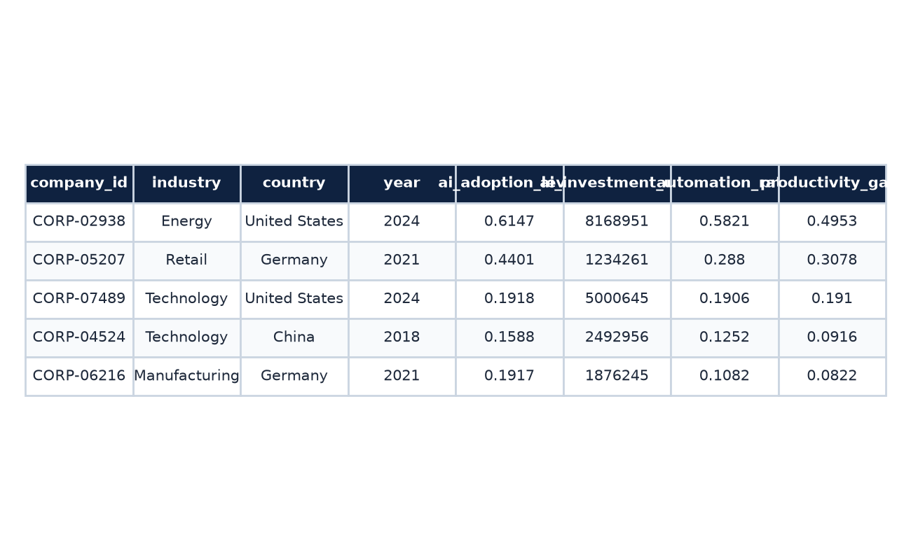
RAW DATA METRICS
Dataset Description
Dataset Information
📊 Total Records: 104,845 rows
🏢 Unique Companies: 8,000 corporate IDs
🏭 Industries Covered: 10 distinct sectors
🌍 Countries Analyzed: 15 unique nations
📅 Time Period: 2015 – 2025
📋 Features: 13 variables tracked

Slide 4
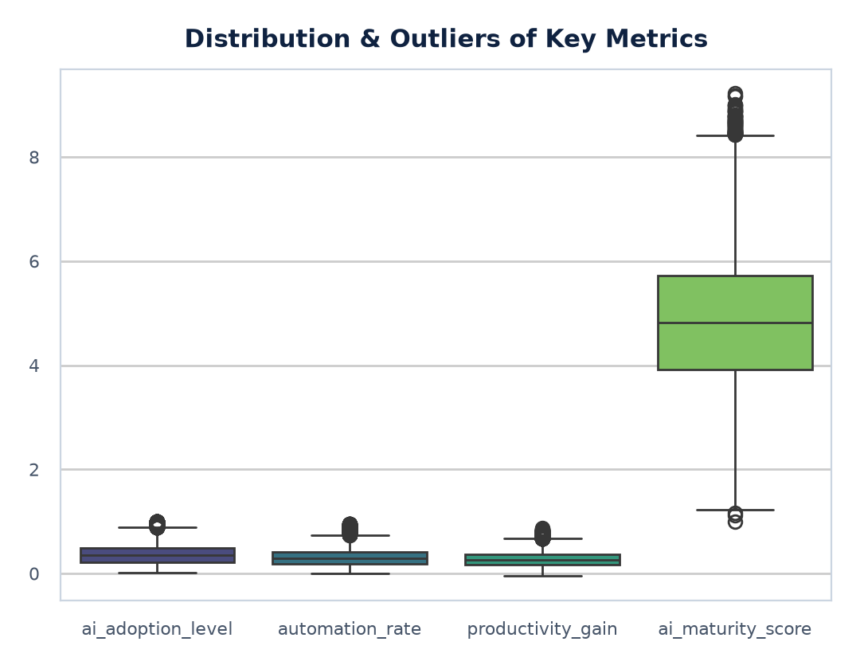
DATA CLEANING & EDA
Data Cleaning & Preprocessing
Data Cleaning Pipeline
✔ Missing Values → 0: Verified zero null cells across all features.
✔ Duplicate Rows → 0: Confirmed completely unique observation rows.
✔ Correct Data Types: Verified formatting (floats, integers, categorical).
✔ Unique Categories Verified: Checked industry and country uniqueness for spelling or integrity issues.
✔ Outlier Detection: Outliers in financial metrics identified via Z-scores and kept since they represent genuine large company variations.

Slide 5
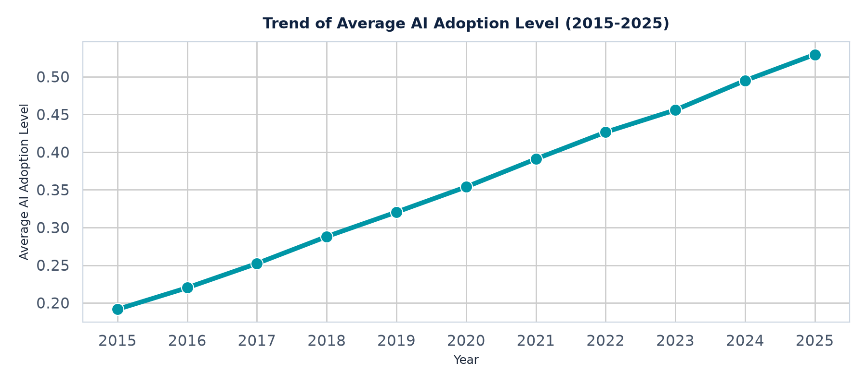
TEMPORAL ADOPTION GROWTH
AI Adoption Trend (2015-2025)
Observation: AI adoption increased steadily between 2015–2025.
Business Insight: Organizations are increasingly integrating AI into business operations.

Slide 6
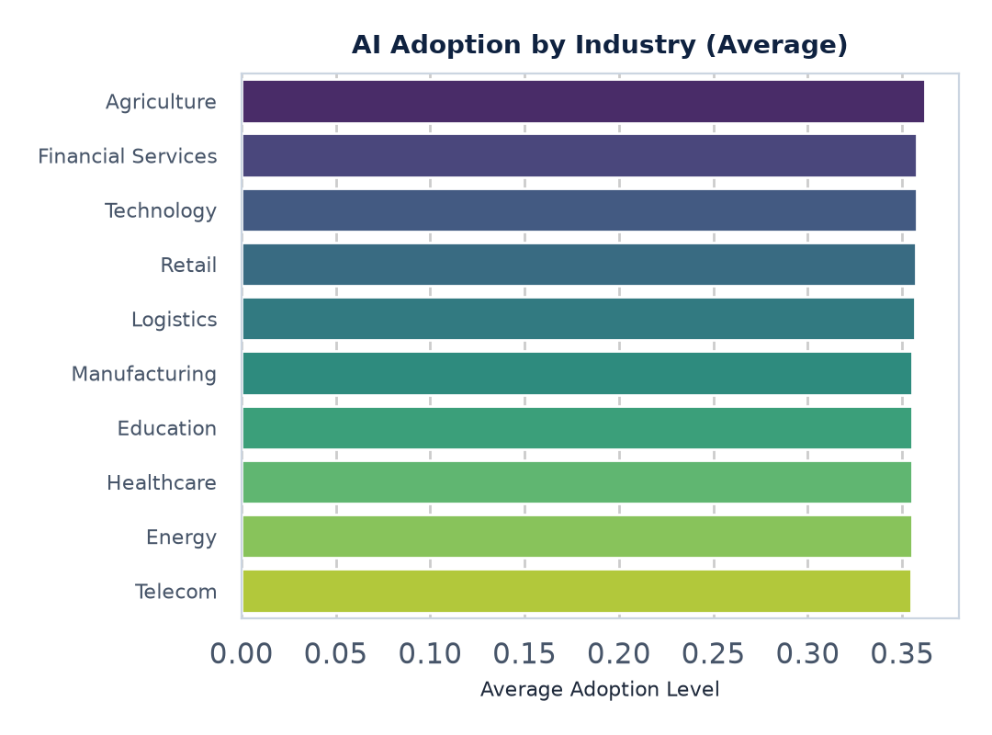
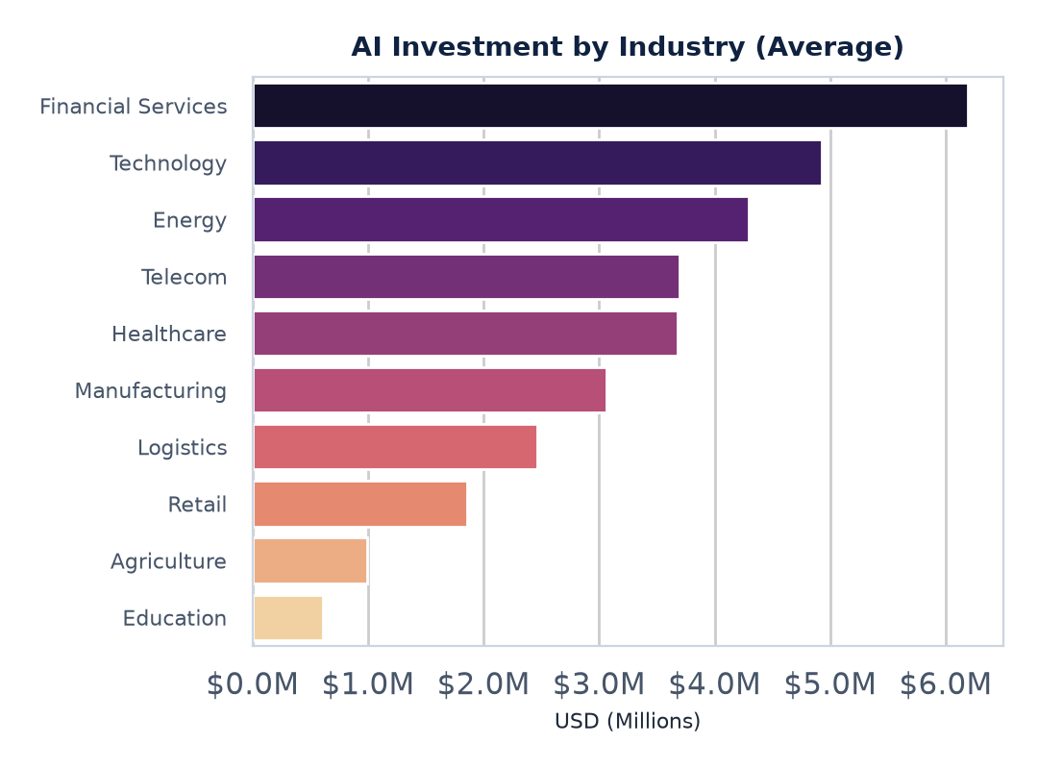
DATA CLEANING & EDA
AI Adoption & Investment Across Industries
Observation: Adoption is relatively consistent across industries, but Financial Services invests the most in AI.

Slide 7
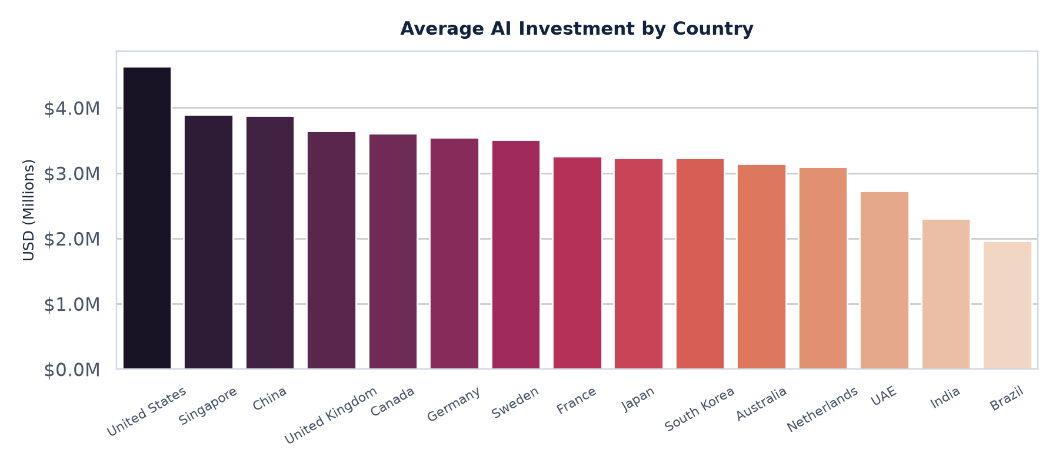
NATIONAL VARIANCE ANALYSIS
AI Investment by Country
Observation: United States has the highest average investment, while India and Brazil have comparatively lower investment.

Slide 8
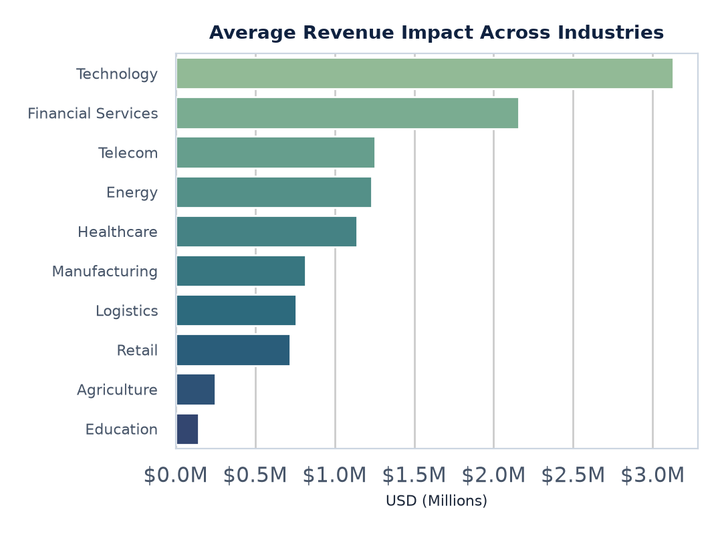
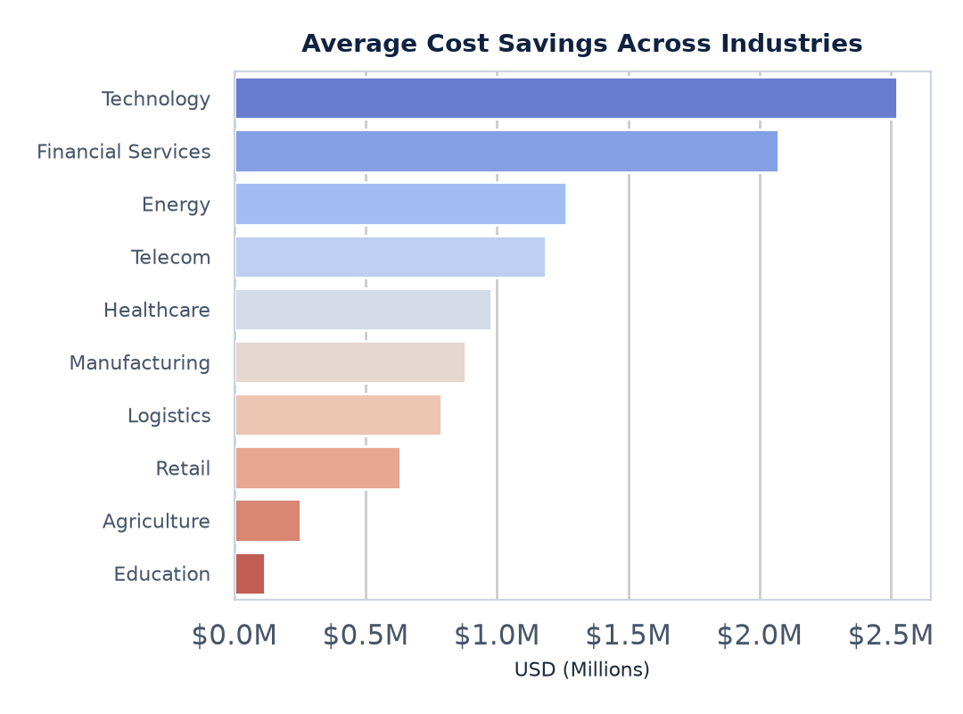
DATA CLEANING & EDA
Business Performance: Revenue & Cost Savings
Observation: Technology achieves the highest revenue impact. Technology also records the highest cost savings.

Slide 9
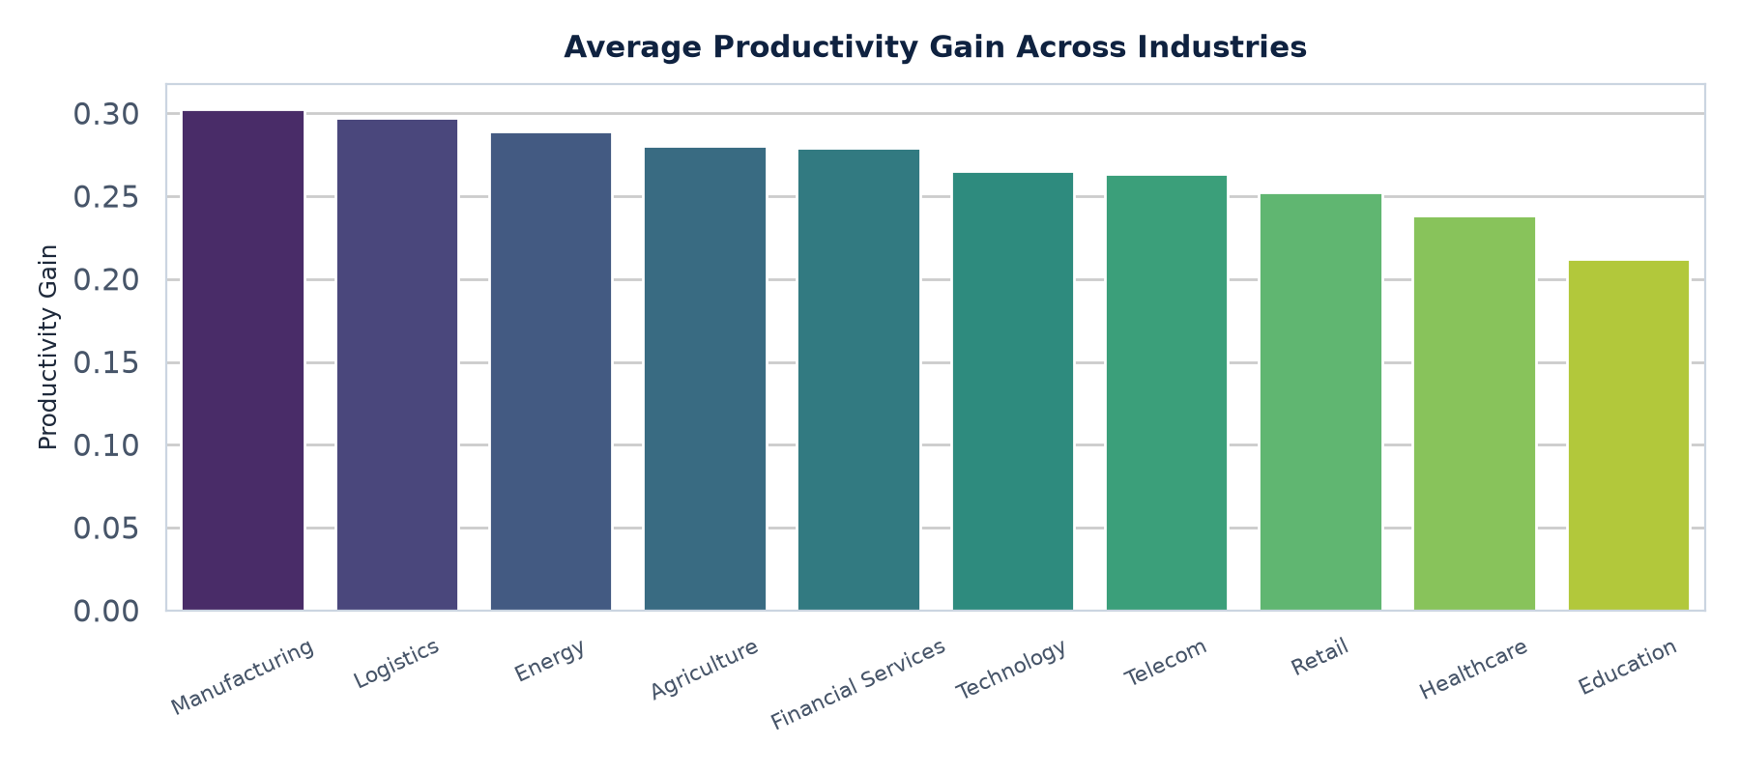
OPERATIONAL EFFICIENCY GAINS
Productivity Analysis by Industry
Observation: Manufacturing and Logistics have the highest productivity gains.

Slide 10
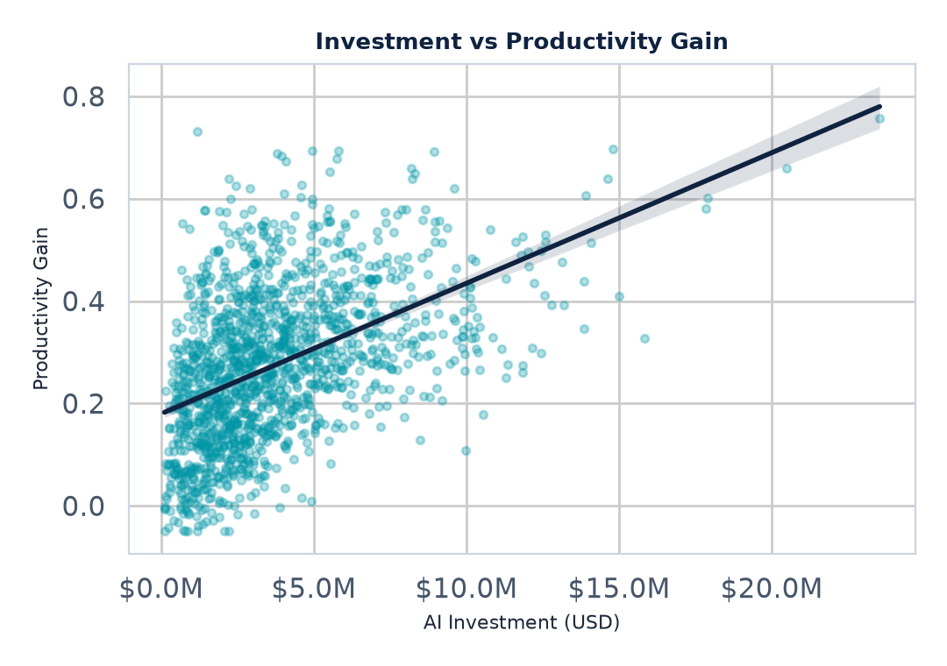
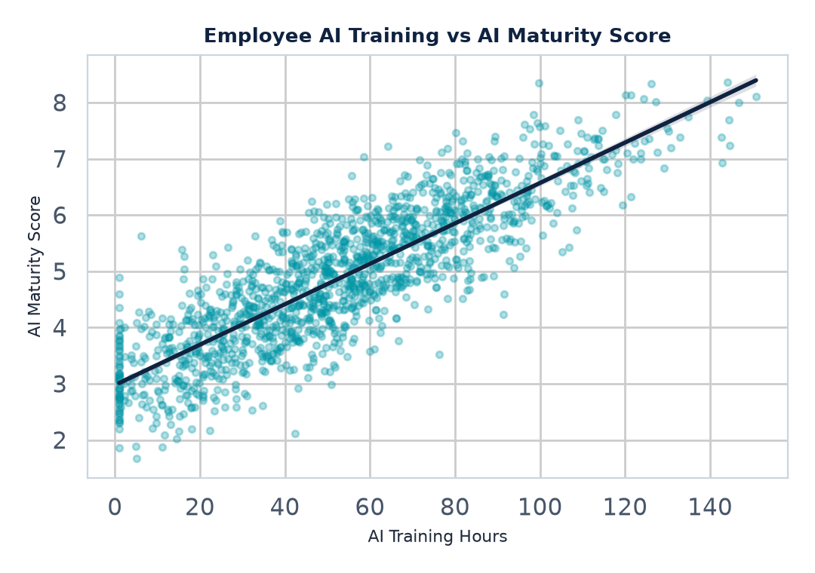
DATA CLEANING & EDA
Relationship Analysis: Regression Plots
0.845
Correlation: Training vs AI Maturity
Key Observations:
• AI Investment has a positive but moderate relationship with Productivity Gain. • Employee Training has an exceptionally strong positive relationship (r = 0.845) with AI Maturity, demonstrating that training is a crucial builder of capability.

Slide 11
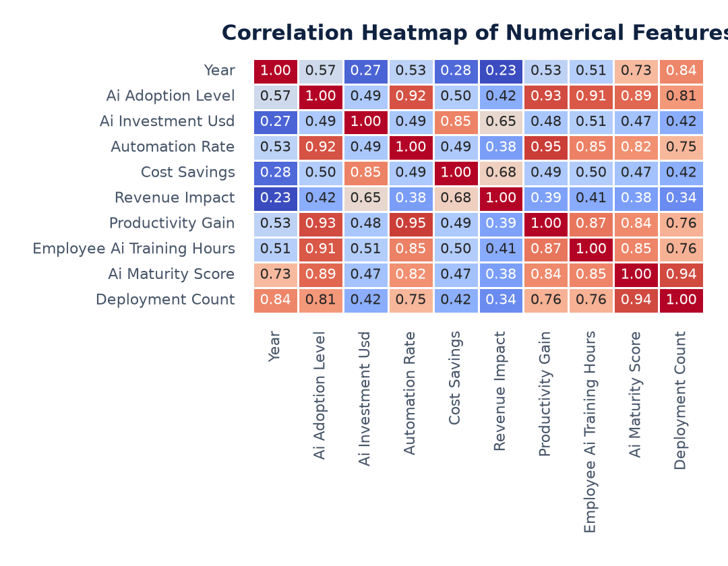
DATA CLEANING & EDA
Correlation Heatmap
Strongest Linear Relationships
• Automation ↔ Productivity = 0.95
• AI Maturity ↔ Deployment = 0.94
• AI Adoption ↔ Productivity = 0.93
• Training ↔ AI Maturity = 0.85

Slide 12
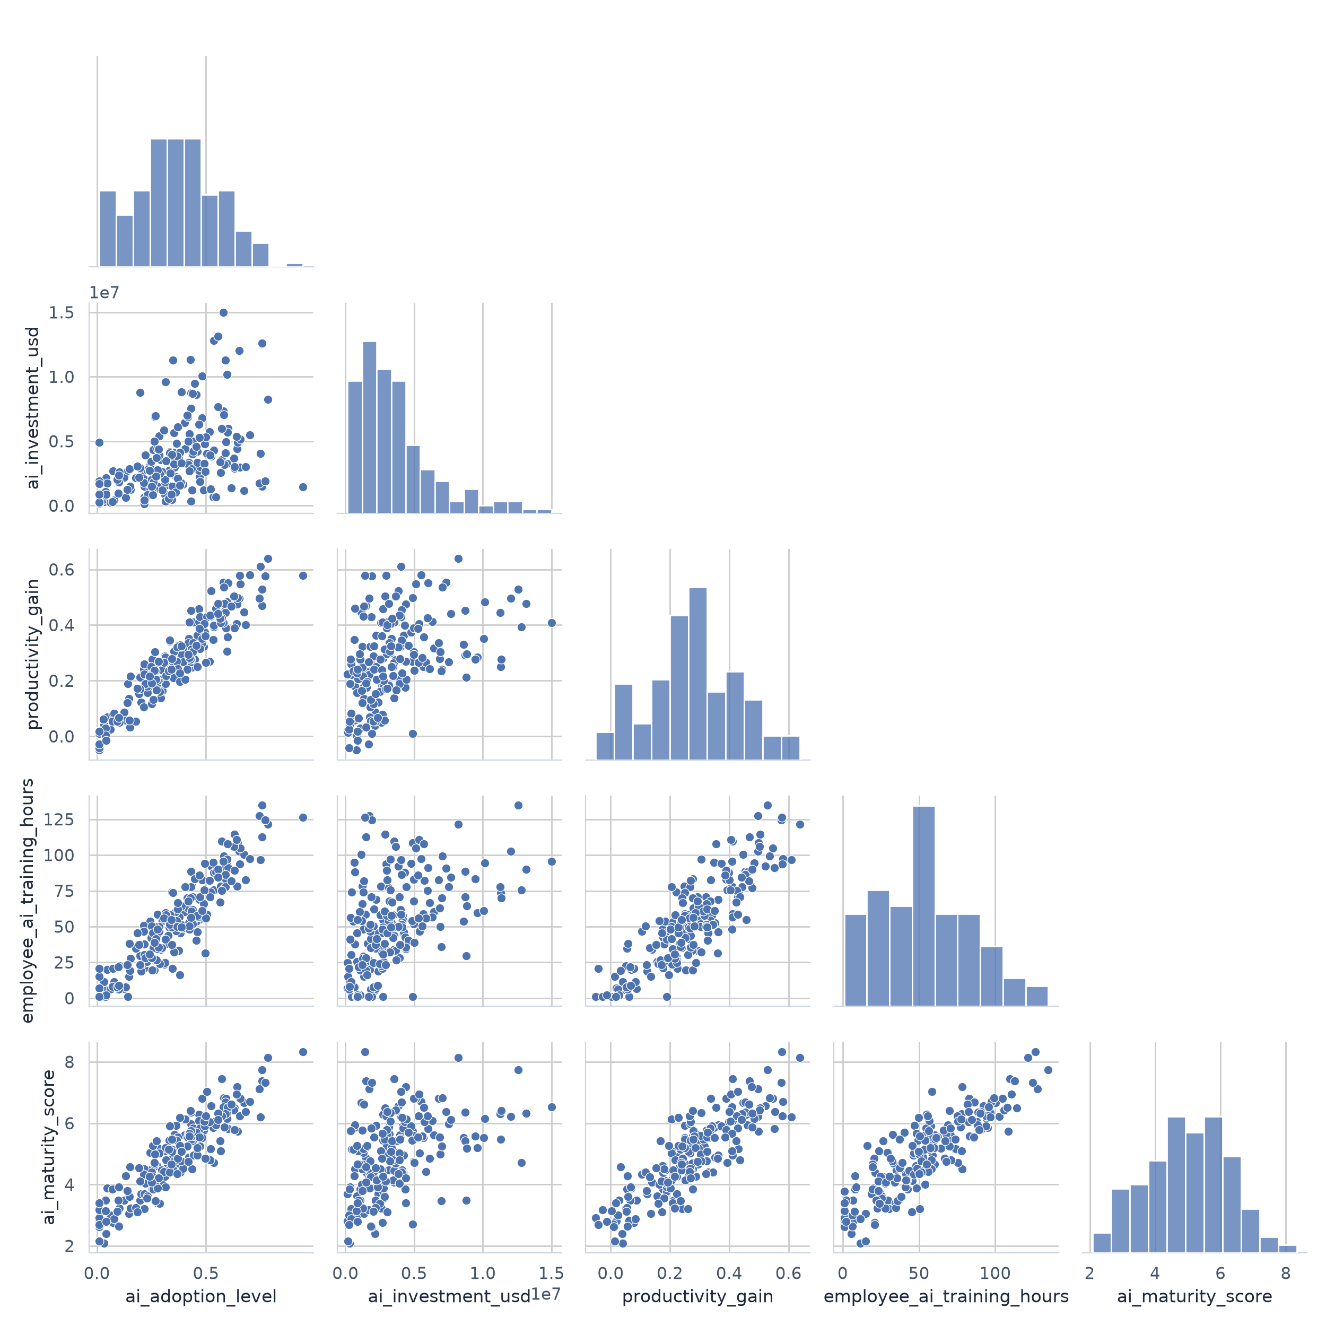
MULTI-VARIABLE INTERACTIONS
Pair Plot Visualization
Pair Plot Observations
• Strong positive relationships among major variables.
• AI Investment shows greater variability.
• Employee Training closely aligns with AI Maturity.

Slide 13
ANALYTICAL TAKEAWAYS
Key Insights
📈 AI adoption increased over time.
💰 Financial Services invests the most.
🏭 Manufacturing has highest productivity.
🧑‍🏫 Employee training strongly improves AI maturity.
🤖 Automation improves productivity.
💵 Technology generates highest revenue.

Slide 14
CHANGES WE CAN MAKE
Actionable Recommendations
✔ Increase employee AI training.
✔ Improve AI maturity.
✔ Expand automation.
✔ Invest strategically.
✔ Measure AI performance regularly.
✔ Build long-term AI strategy.

Slide 15
Conclusion
AI adoption has grown consistently between 2015 and 2025, driving significant improvements in productivity, revenue, and cost savings across industries. A balanced strategy that combines financial investment, process-wide automation, and robust employee training is crucial for organizations to maximize their AI returns and build long-term AI maturity.
Thank You

